Slide 1
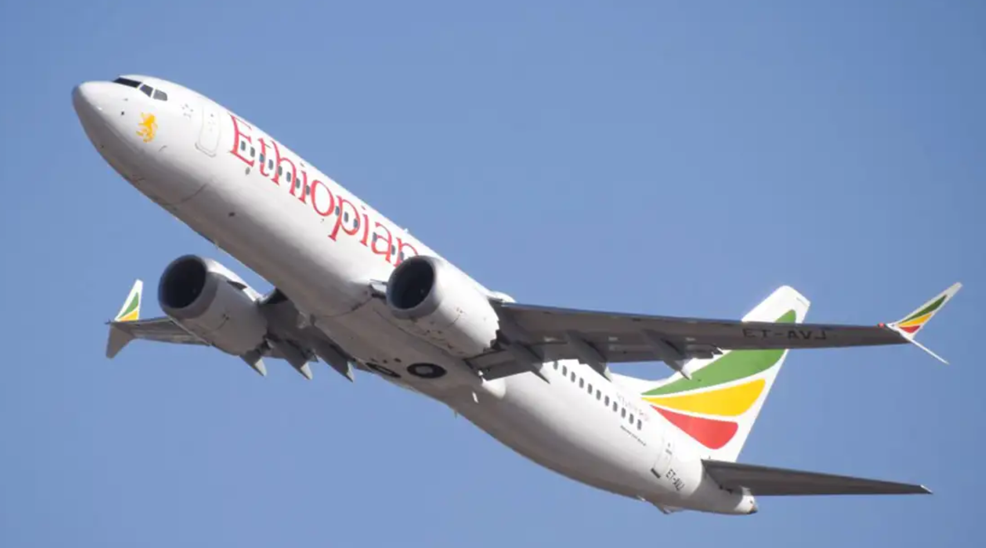
Sentiment Analysis on Ethiopian 737 Max 8 Air Crash

Slide 2

Objective
Data Collection Methods
Text Analysis Workflow
Data Cleaning/Pre-Processing
Frequent Term Analysis
Word Cloud Analysis
Dendrogram
Topic Modeling
Sentiment Analysis
Conclusion

Slide 3
Objective
“The purpose of this presentation is to present global sentiments of recent "Ethiopian Boeing
737 MAX 8" plane crash disaster. Collected tweets from Twitter and using the techniques
learned in the course, analyzed the data and captured the insights and sentiments of
the global audience”

Slide 4
Data Collection Methods
Used Popular micro-blogging site, Twitter as a data source
Used search feature to extract the recent tweets
Used GetOldTweets package to extract the old tweets

Slide 5
Text analysis workflow
Tweets data for Ethiopian Boeing 737 max 8 air crash
Load the tweets data from csv file (downloaded using Tweepy package)
Cleaning of tweets data
Frequent term analysis
Word Cloud analysis
bi-gram analysis
Dendrogram
Topic Modeling using LDA technique
Sentiment analysis ( emotions, polarity & score)

Slide 6
Data Cleaning/Pre-Processing
Tweets data for Ethiopian Boeing 737 max 8 air crash
Convert tweets data into corpus
Remove first letter of all the tweets (as it is found that all tweets start with letter ‘b’)
Remove retweets
Remove @ references from the tweets
Convert tweet text to lower case
Replace abbreviations with their full text equivalents
Replace common symbols with word equivalents
Remove punctuations from the corpus
Remove common and customised stop words
Remove the links (URLs)
Remove Single letter words
Remove Extra Whitespace
Stemming the cleaned corpus

Slide 7
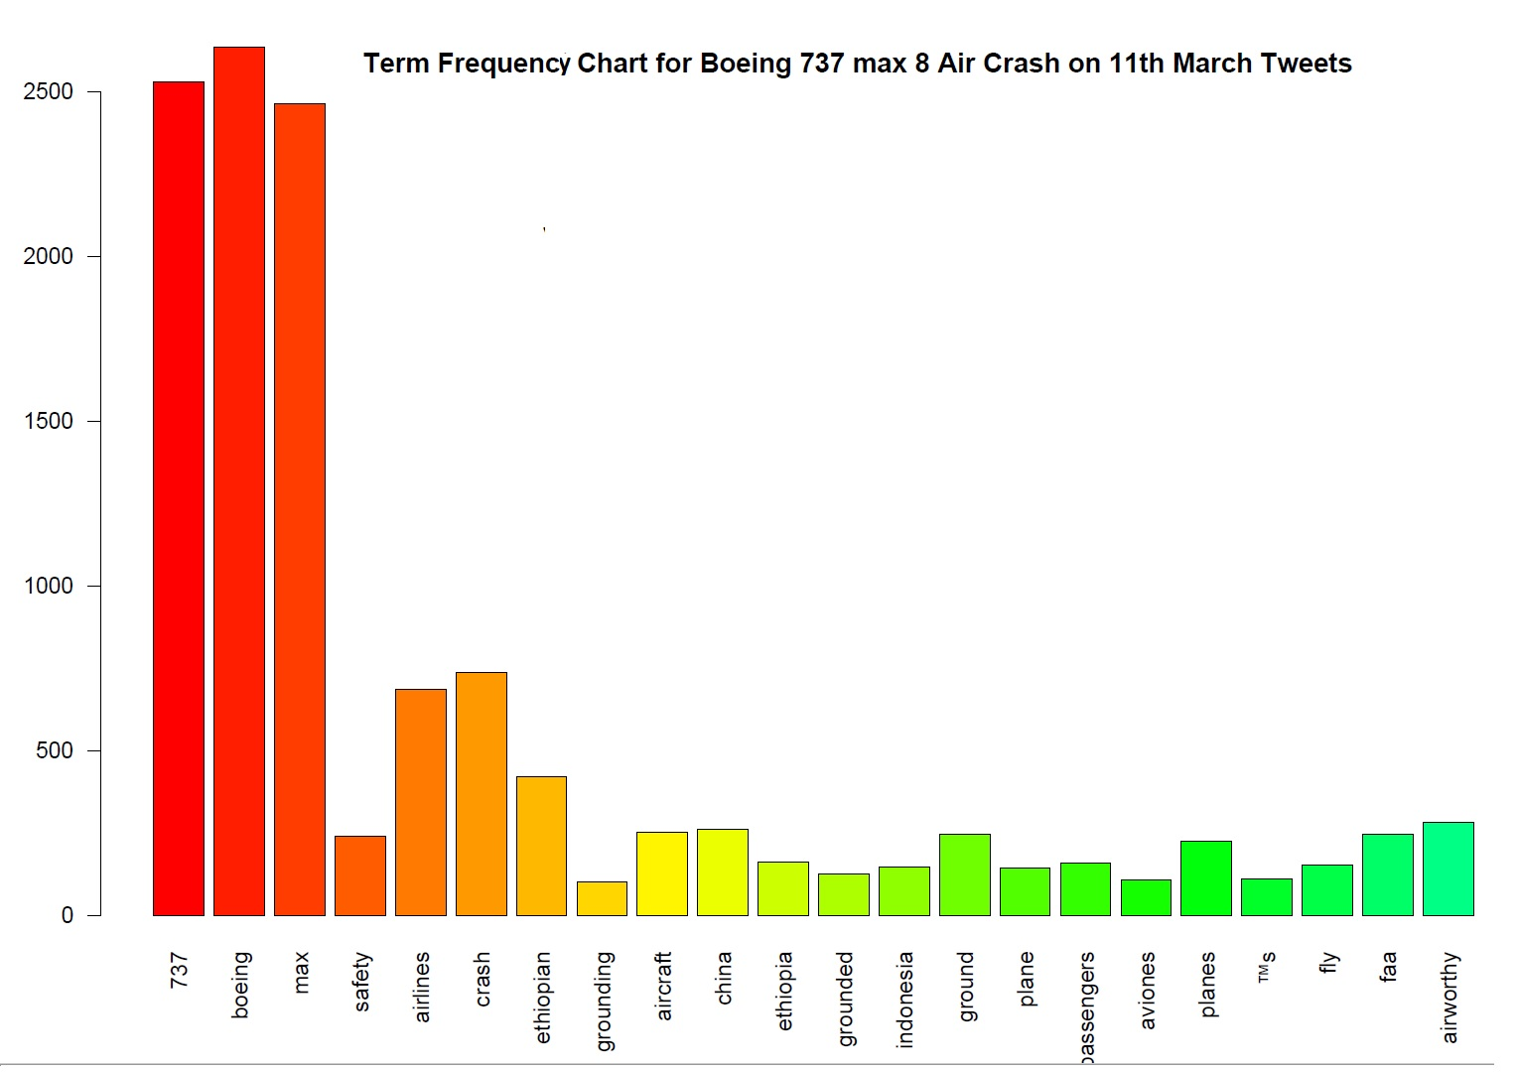
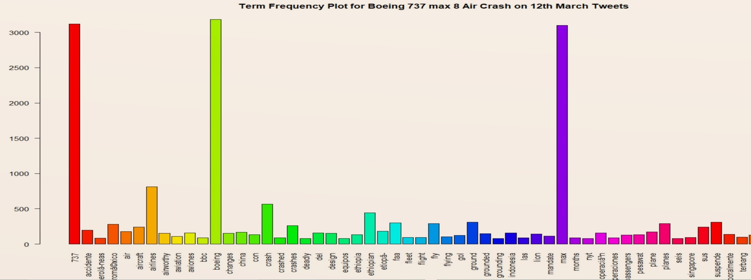
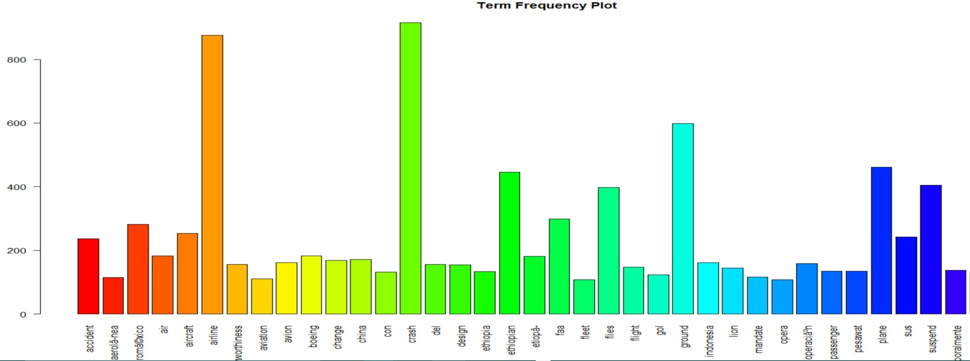
Frequent Term Analysis
Identify terms frequently used in the tweets Boeing 737 max 8 air crash
Inferences
Plotted with most frequent terms whose frequency > 75
Dominated by terms Boeing 737 MAX followed by crash and airlines name, Ethiopian
When it comes to Boeing 737 MAX most of the people interested talking planes are grounded.
Words like "China" ,"Indonesia" indicates, People talking 737 grounded in these countries
People are discussing crash similarities with Lion airlines 737 and also the design of the aircraft

Slide 8
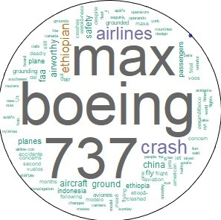
Word Cloud Analysis
More insights from the tweets
Inferences (Day after Tragedy)
Most discussed words are about Boeing 737 MAX crash, Ethiopian, grounding
This indicates that when its comes to Boeing 737 MAX, “crash” and “air craft grounded” are the hottest topics on the social media
China and Indonesia ordered grounding of flights is another hot topic in the social media

Slide 9
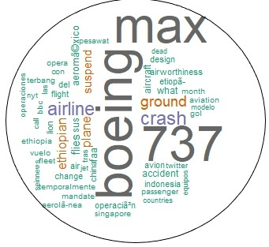
Word Cloud Analysis
More insights from the tweets
Inferences (Two Days after Tragedy)
New word “suspend” is the hot topic in the social media
People are discussing crash similarities with Lion airlines 737 and also the design of the aircraft

Slide 10
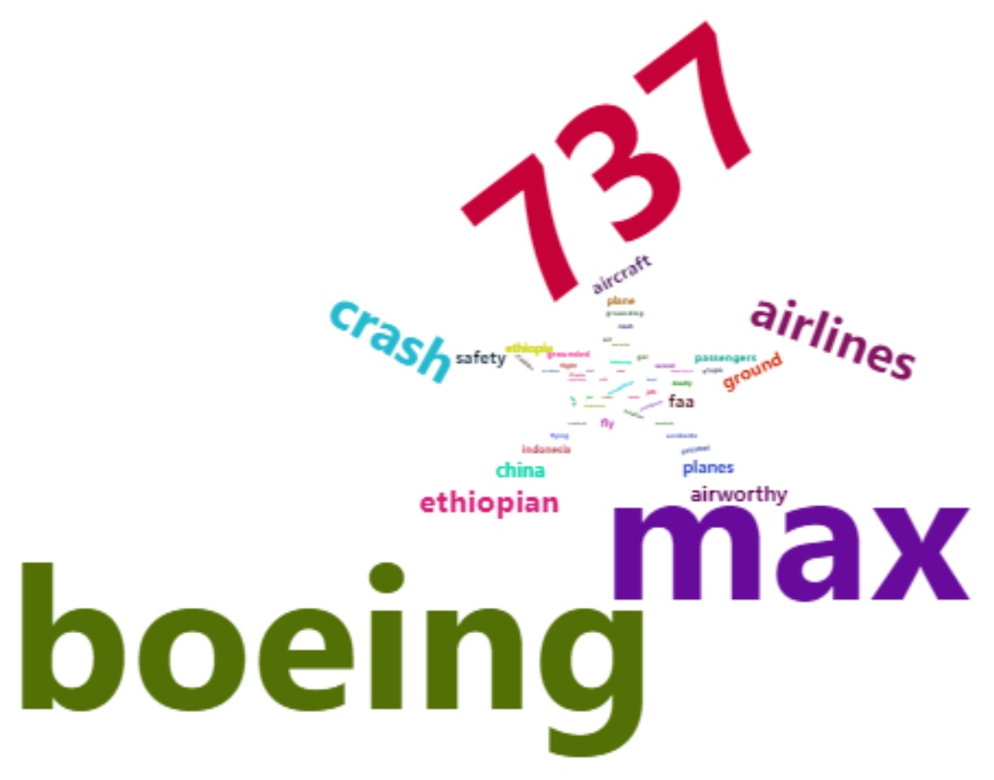
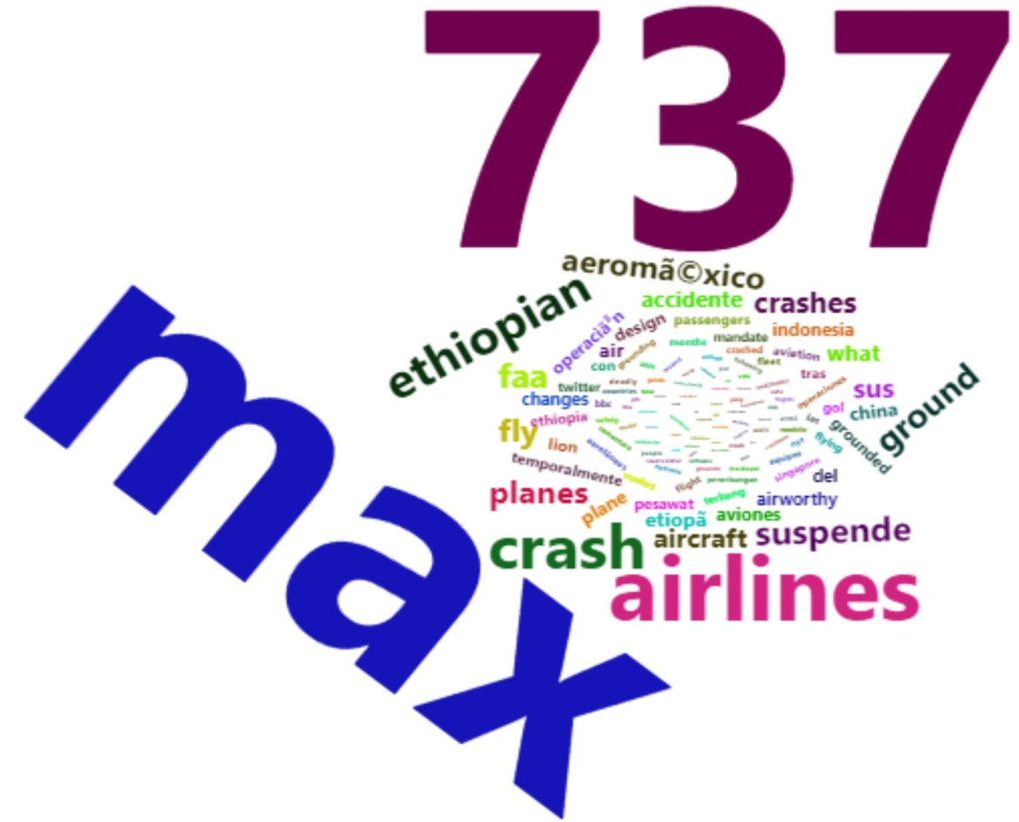
Word Cloud Analysis
Using Word Cloud 2
Inferences
Words Boeing, 737, max, crash, Ethiopian, China and Indonesia ground are the hot topics on the social media
Word “suspend”, crash similarities with Lion airlines 737 and design of the aircraft are the topics on social media

Slide 11
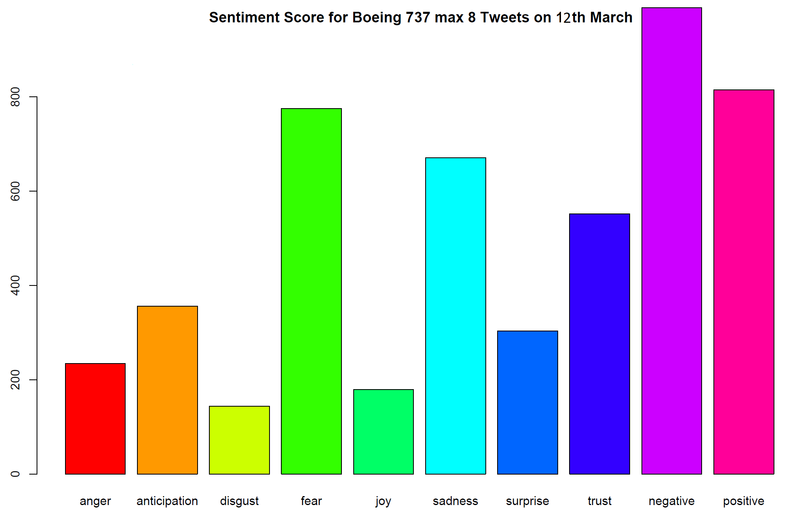
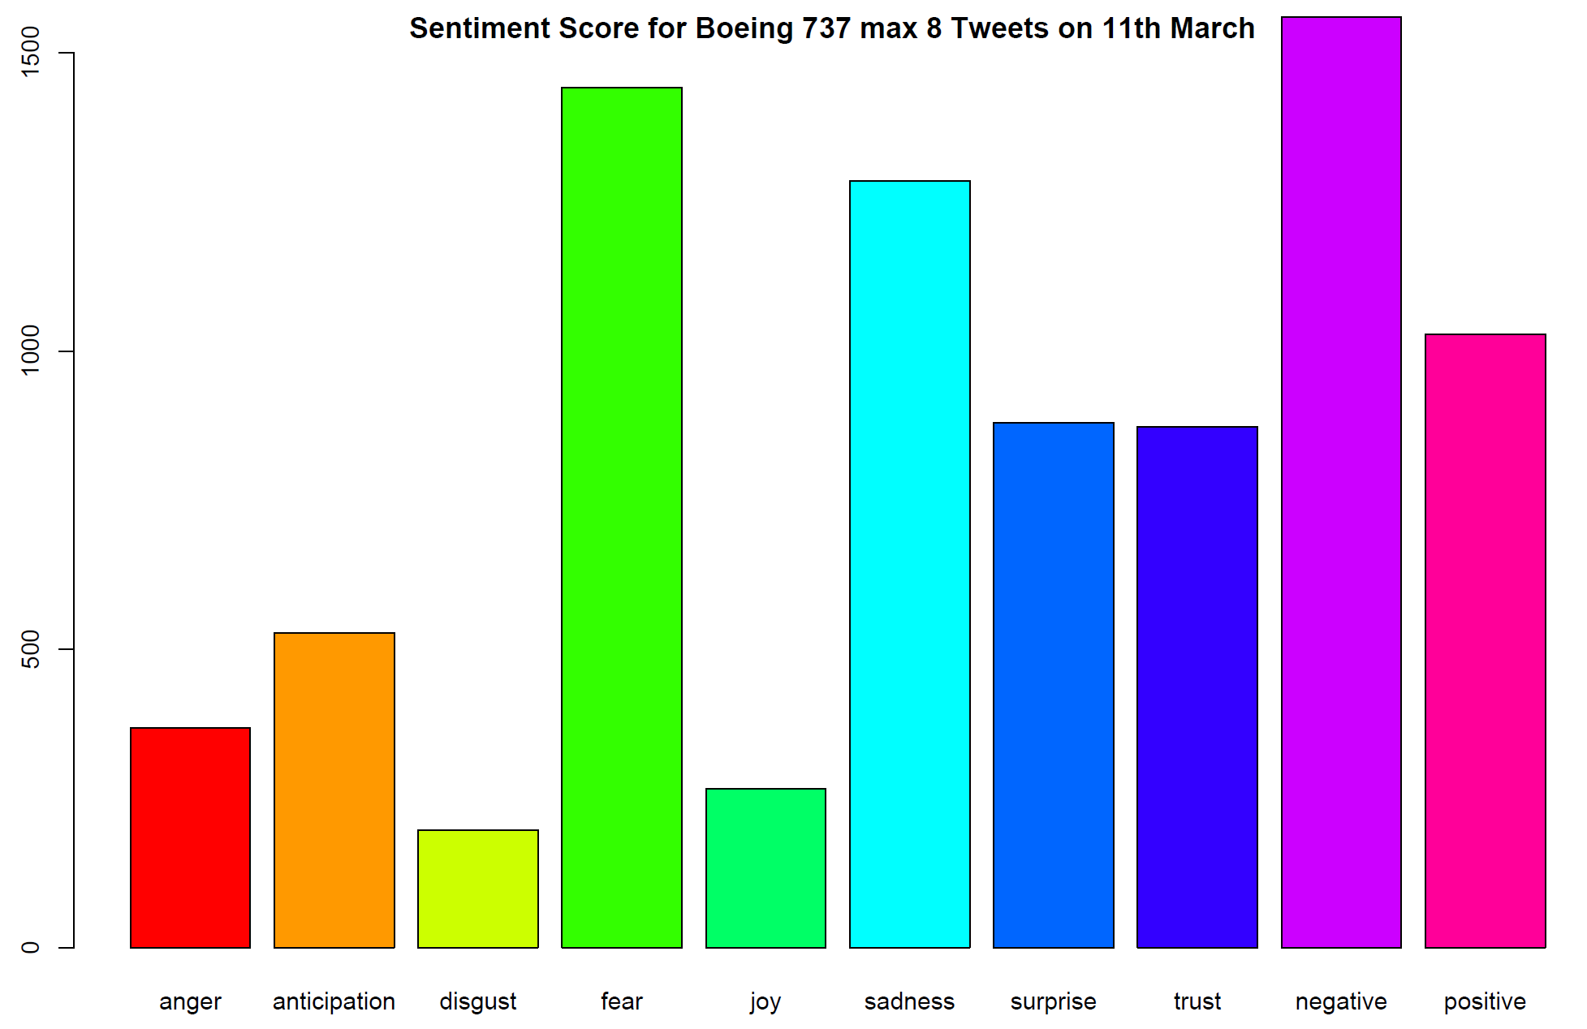
Word Cloud Analysis
Sentiment Score based on NRC sentiment dictionary
Calculate the presence of eight emotions and their corresponding valence for each tweet

Slide 12
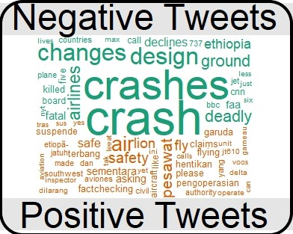
Word Cloud Analysis
Positive and Negative Tweets based on NRC sentiment dictionary
Negative
Crash (Dominating)
Deadly
Killed
Fatal
Design
Ground
Positive
fact checking

Slide 13
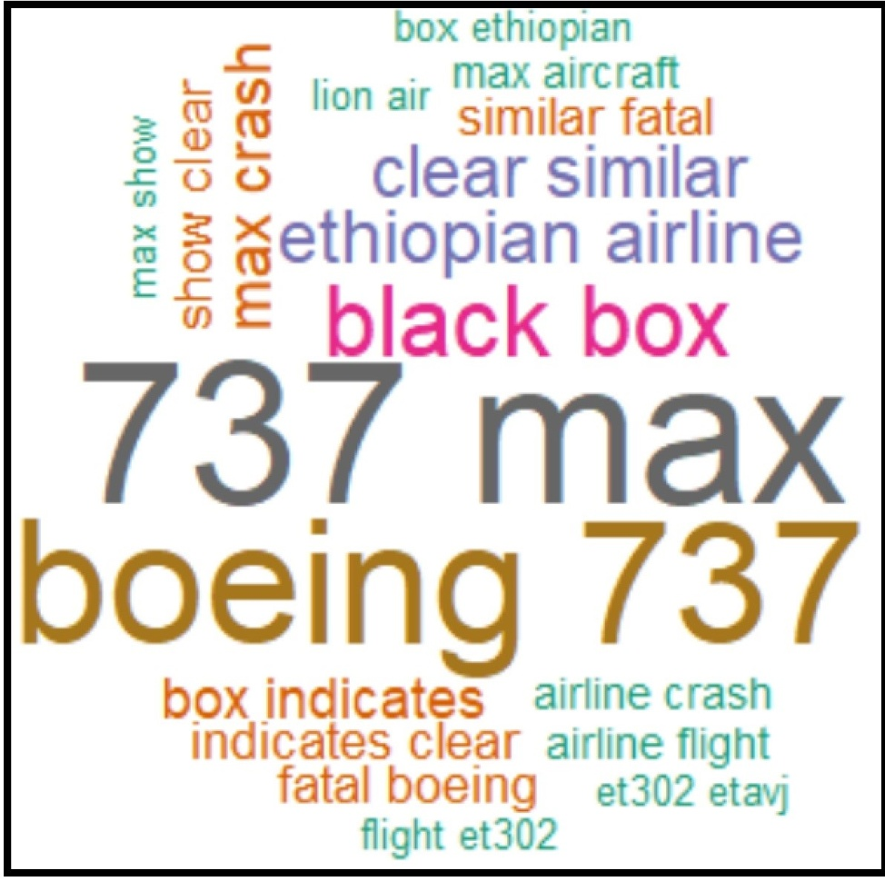
Word Cloud Analysis
bigram analysis - containing two words to extract useful phrases
Provides better insights
boeing 737
flight et302
ethiopian airline
black box
similar fatal
indicates clear
clear similar
lion air ....etc

Slide 14
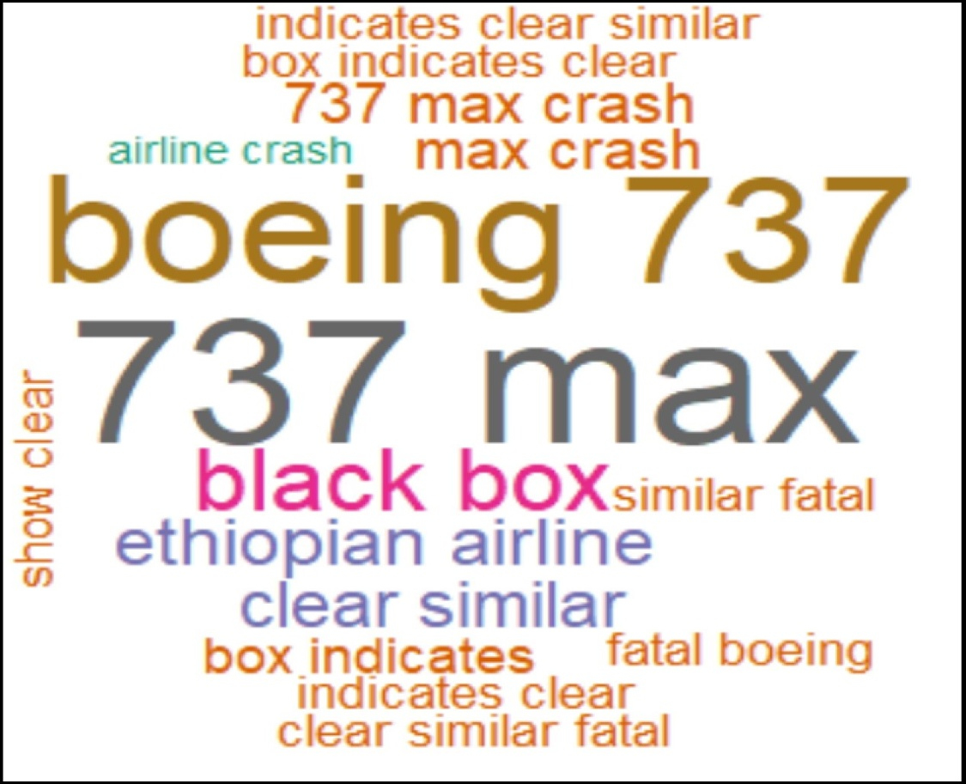
Word Cloud Analysis
trigram analysis - containing three words to extract useful phrases
Provides better insights
737 max crash
indicates clear similar
box indicates clear
clear similar fatal

Slide 15
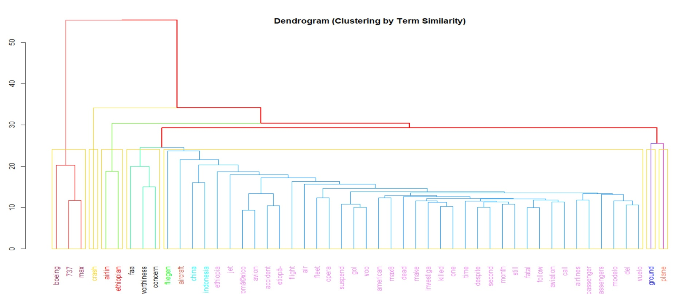
Dendrogram
Clustering by Term Similarity - Hierarchical Clustering TDM
Inferences :
Cluster 1 terms represents the model of the plane
Cluster 2 & 3 terms represents the name of airlines that meet with incident
Cluster 4 terms represents Federal Aviation Administration (faa) concerned
about the crash
Cluster 5 terms represents passengers are dead. China and Indonesia
suspended make max8 planes and investigation in progress
Cluster 6 & 7 terms represents planes have been grounded
The goal is to perform word cluster analysis on TDM
Calculate distance between words & cluster words according to similarity

Slide 16
Dendrogram
Clustering by Term Similarity - Hierarchical Clustering TDM
Inferences :
Cluster 1 terms represents the model of the plane
Cluster 2 & 3 terms represents the name of airlines that meet with incident
Cluster 4 terms represents Federal Aviation Administration (faa) concerned
about the crash
Cluster 5 terms represents passengers are dead. China and Indonesia
suspended make max8 planes and investigation in progress
Cluster 6 & 7 terms represents planes have been grounded

Slide 17
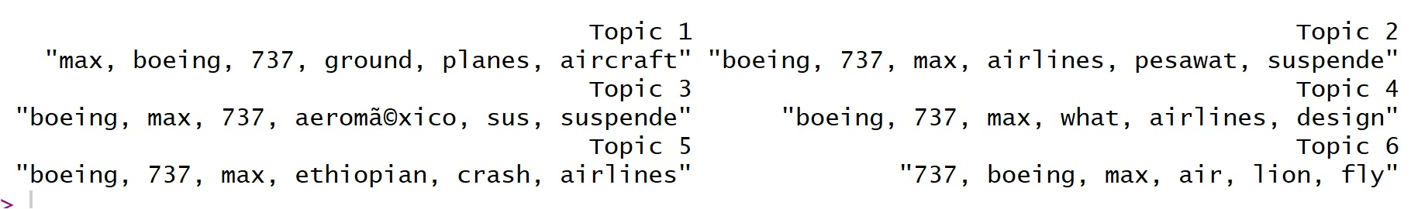
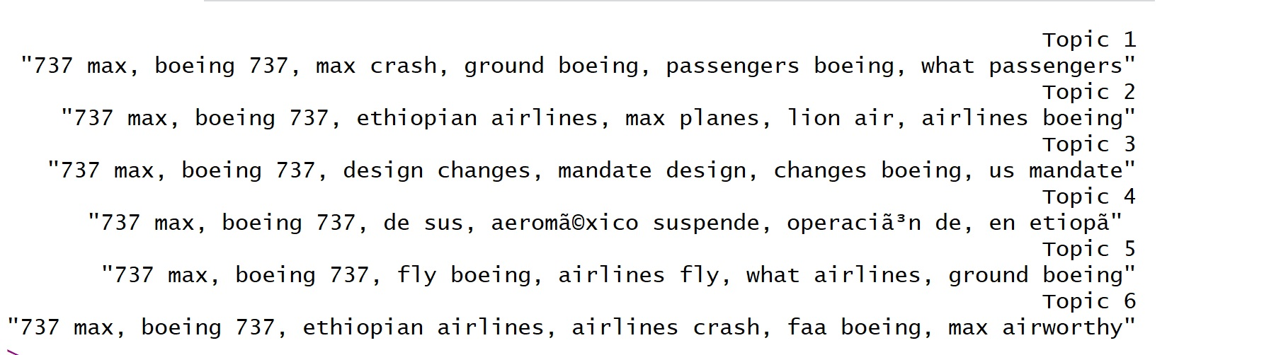
Topic modeling
Latent Dirichlet Allocation method - uni-gram & bi-gram tokens
Inferences: Main topics most discussed about Boeing737max8 crash
Topic 1: Crash and planes grounded
Topic 2: Model 737 suspended and compares with Lion air crash
Topic 3: Design change mandate for Boeing 737

Slide 18
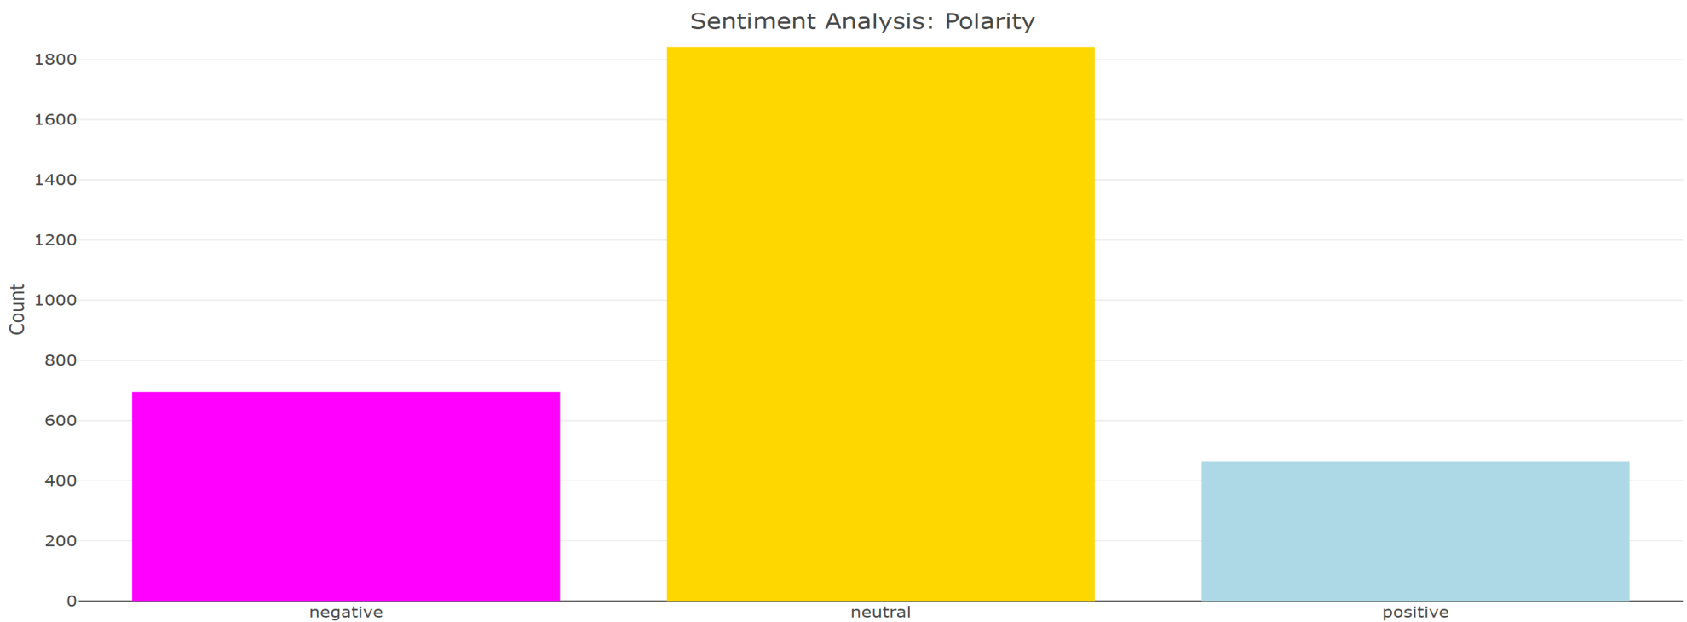
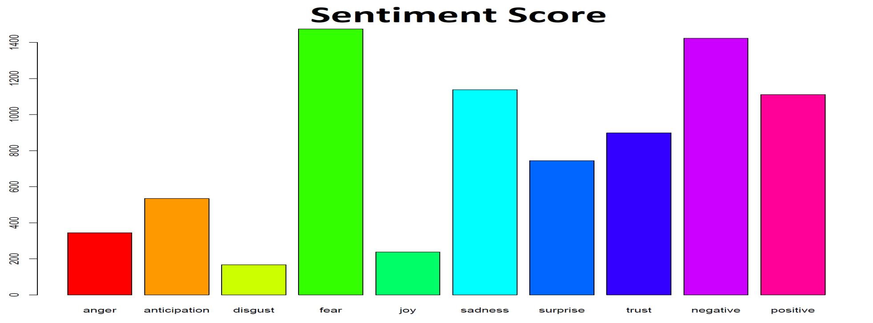
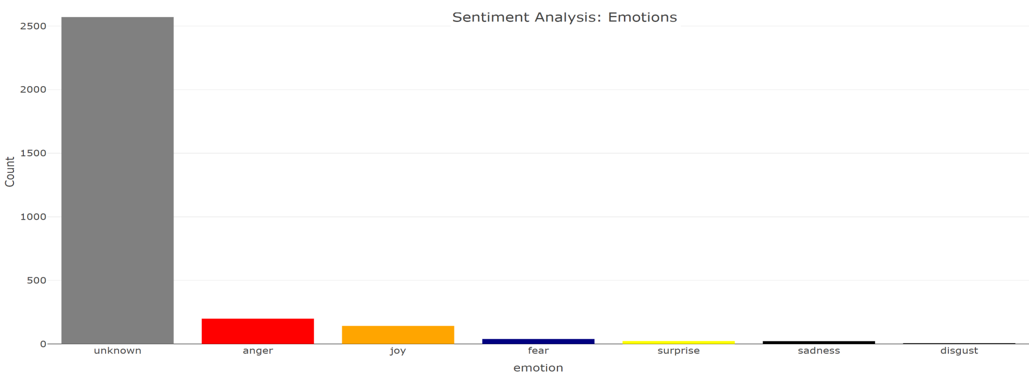
Sentiment Analysis
Emotions, Score and Polarity of Emotions
Inferences from sentiment analysis of tweets:
People prefer to use more anger words about Boeing 737 max 8
Lot of unknown emotions. Should be able to classify the polarity reasonably well
Overall sentiment score is negative. Negative vibes in the social media

Slide 19
Conclusion
After analyzing the insights and sentiments of the tweets,
- Found to be people demonstrating anger over the fatal accident.
- Overall sentiment score is negative
- Negative emotions such as Fear, Sadness and Anger are dominating
There are strong negative vibes about Ethiopian 737 Max 8 Air Crash in social media

Slide 20
Questions

Slide 21
Thank you!

